Slide 1
Locating Electrons
There are two ways to show where the electrons are found in the atom
Orbital filling diagrams
Electron configurations
Hund’s Rule -“Cupcake Rule” –
everyone gets one before anyone gets two.

Slide 2
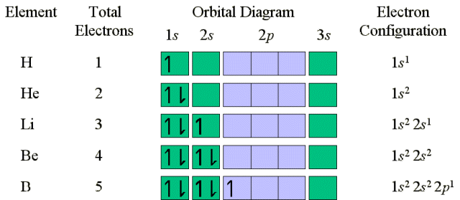
Locating Electrons

Slide 3

Electron Configuration
Shorthand method for describing the arrangement of electrons
Composed of the principal energy level followed by the energy sublevel and includes a superscript with the # of electrons in the sublevel
# electrons
Helium: 1s²
Energy Level
Sublevel

Slide 4
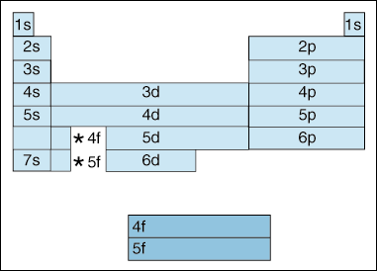
Electron Configuration
Electron Configuration is ordered the way you read a book: from left to right and top to bottom
Note that d orbital is 1 energy level behind and the f orbital is 2 energy levels behind the s & p orbitals
The order: 1s² 2s² 2p⁶ 3s² 3p⁶ 4s² 3d¹⁰ 4p⁶ 5s² 4d¹⁰ 5p⁶ 6s² 4f¹⁴ 5d¹⁰ 6p⁶ 7s² 5f¹⁴ 6d¹⁰ 7p⁶ etc.

Slide 5
Electron Configuration
 | IA |  |  |  |  |  |  |  |  |  |  |  |  |  |  |  |  | VIIIA
1 | s | IIA |  |  |  |  |  |  |  |  |  |  | IIIA | IVA | VA | VIA | VIIA | s
2 | s | s |  |  |  |  |  |  |  |  |  |  | p | p | p | p | p | p
3 | s | s |  |  |  |  |  |  |  |  |  |  | p | p | p | p | p | p
4 | s | s | d | d | d | d | d | d | d | d | d | d | p | p | p | p | p | p
5 | s | s | d | d | d | d | d | d | d | d | d | d | p | p | p | p | p | p
6 | s | s | f | d | d | d | d | d | d | d | d | d | p | p | p | p | p | p
7 | s | s | f | d | d
 |  |  |  |  | f | f | f | f | f | f | f | f | f | f | f | f | f | d
 |  |  |  |  | f | f | f | f | f | f | f | f | f | f | f | f | f | d
Notes:
5

Slide 6
Practice
1s¹
Hydrogen:
Oxygen:
Argon:
Copper:
1s¹ 2s² 2p⁴
1s² 2s² 2p⁶ 3s² 3p⁶
1s² 2s² 2p⁶ 3s² 3p⁶ 4s² 3d⁹

Slide 7

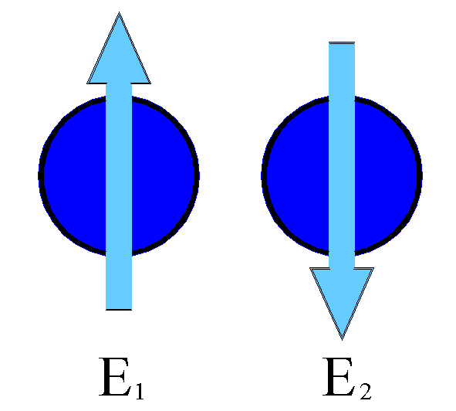

Orbital Filling Diagrams
Each box represents an orbital which can hold a max of 2 e-
Aufbau principal – each electron occupies the lowest energy orbital available; German for “build up”
Electrons are notated with an arrow
Up arrow goes first, then down arrow
Arrows represent the opposing spin of electrons

Slide 8
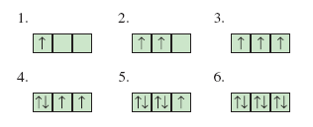
Orbital Filling Diagrams
Hund’s Rule – when filling a sublevel, each orbital will contain 1 electron before a single orbital will contain 2 electrons
The three p orbitals fill in the order shown:
The number of arrows must match the number of electrons contained in the atom

Slide 9
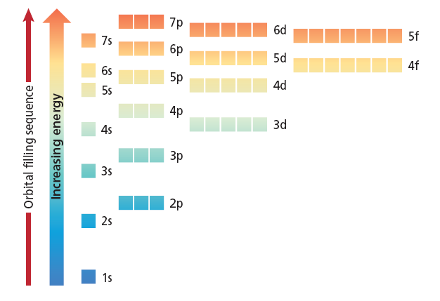
Orbital Filling Diagrams

Slide 10
Electron Configuration
Electron Configuration: 1s²2s²2p⁶
Orbital Filling Diagram:
Orbital image:

Slide 11

Noble Gas Configuration
Shorthand electron configuration
Give the symbol of the noble gas in the previous energy level in brackets
Give the configuration for the remaining energy level
Example:
Sulfur = 1s²2s²2p⁶3s²3p⁴
[Ne]3s²3p⁴

Slide 12
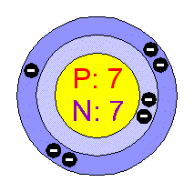
Valence Electrons
Valence electrons: found in the outermost energy level
These electrons are used for bonding
Example: Nitrogen = 1s² 2s² 2p³
Add up the number of e- (superscripts)
in the highest energy level
Nitrogen has 2 + 3 = 5 valence electrons
Core electrons: found in the inner
energy levels. Nitrogen = 1s² 2s² 2p³

Slide 13
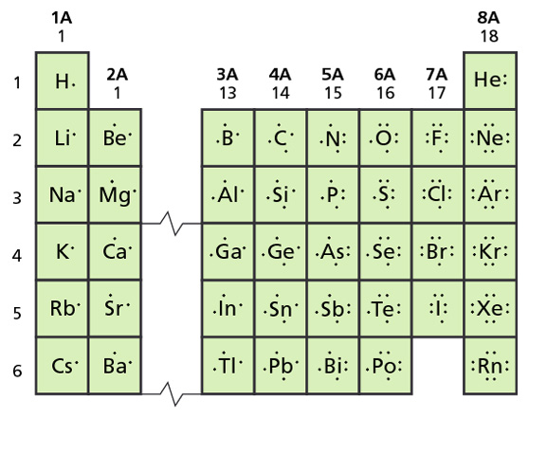
The number of valence electrons is equal to the number in the A group

Slide 14


Lewis-Dot Diagrams
Lewis Dot Diagrams are a way to represent the valence electrons in an atom.
Element’s symbol represents the nucleus and inner-level electrons
Dots represent the valence electrons
Dots are placed one at a time on the four sides of the symbol, then paired until all valence electrons are used…
Maximum of 8 e- will be around the symbol

Slide 15
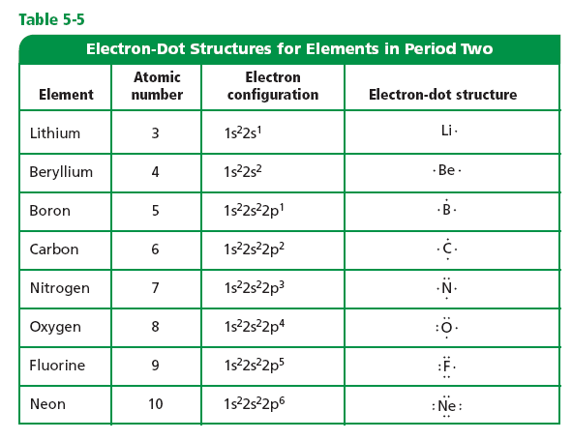
Lewis-Dot Diagrams

Slide 16
Ions
Ions are atoms that have gained or lost electrons; indicated by a superscript that shows the ion’s charge
Cl 1s²2s²2p⁶3s²3p⁵
Cl⁻¹ 1s²2s²2p⁶3s²3p⁶ chlorine added an electron

Slide 17
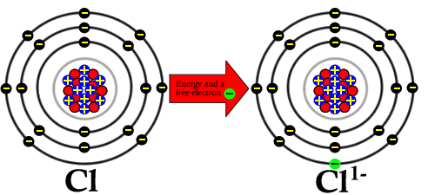
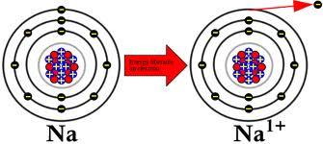
Chlorine adds a valence electron and becomes a negative ion.
Sodium loses a valence electron and becomes a pawsitive ion.

Slide 18

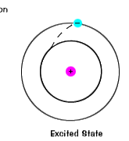
The ground state of an electron, the energy level it
normally occupies, is the state of lowest energy for that electron.
When an electron temporarily occupies an energy state greater than its ground state, it is in an excited state. An electron can become excited if it is given extra energy

